Slide 1
Interaction Diagram
Session 21
(Lecture)
Course : Program Design Methods
Effective Period : July 2018

Slide 2
These slides have been adapted from
Britton, C.. (2005). A student Guide to Object Oriented Development. 01. Butterworth-Heinemann. Amsterdam. ISBN: 978-0-7506-6123-2. Chapter 10
Acknowledgement

Slide 3
LO 6 : Design the application using the object oriented design
Learning Objectives

Slide 4
Contents
Introduction
The class diagram
Interaction diagram

Slide 5
Introduction
Detail design activities include the detailed specification of classes, their relationship, and interaction. The models should contain sufficient information to allow them to be used as a program specification

Slide 6
The class diagram
One of the differences between an analysis class diagram and a design class diagram is the amount of detail shown in the models.
Detailed design activities include
  Adding classes, such as interface, control and collection classes to help deliver the solution
  Specifying in detail the links between objects
  Specifying the visibility of attributes and operations
  Specifying attributes in detail
  Specifying operation in detail

Slide 7
Designing associtions
How we implement the association depends on the multiplicity of the association and whether communications is one way or two way

Slide 8
Associations
The direction in which messages are sent is called the navigability of the association.
One way association are referred to as unidirectional
The direction of the navigability is indicated by the arrowhead
Two way navigability can be shown either by an arrowhead on both ends of the association or by having no arrows. However, no arrowheads can also mean that the navigability has not been specified

Slide 9

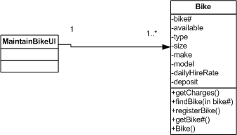
Example
One to one association
One to many association

Slide 10
Designing attributes and operations
Attribute signatures
  During design we need to specify the details of each attribute’s signature.
  The UML format of attribute signature is :
  visibility name : type-expression = intial-value
  Example : #deposit : integer = 0
    #indicates the visibility of the attribute; in this case it is protected
    Deposit is the name of the attreibute
    Integer is its type
    0 – when a bike object created by its constructor, deposit is set to zero

Slide 11
Designing attributes and operations
Operation signatures
  The UML format of an operation signature is:
    Visibility name (parameter list) : return-type
    Example : +findBike(bike#:integer):Bike
      ‘+’ indicates the visibility of the operation. This is a public operation
      findBike is the name of the operation
      bike# : Integer is the parameter for this operation. There can be more than one parameter in which case parameters are separated by commas
      The type returned by this operation is Bike

Slide 12
Interaction Diagram
At the design stage, we need to put more detail on the interaction diagram. However, it is important to remember that the greatest appeal of interaction diagram is their simplicity, so use the extra notation with care.
The added notation includes
  Object creation and deletion
  Iteration
  Conditional behaviour and branching

Slide 13
Object creation and deletion
During the execution of a use case scenario, the group of objects is not necessary fixed; new objects can be created, existing objects can be deleted. Object that are created or deleted in an interaction are called transient objects
the notation of object destruction is a large X at the bottom of the object’s lifeline

Slide 14
Iteration
Notation of iteration
  Asterisk ‘*’ : to indicate a message is sent repeatedly
  A multiobject icon : to indicate a message is sent to many objects
  Outlining the block of messages and adding the iteration clause : to indicate that a series of messages is repeated

Slide 15
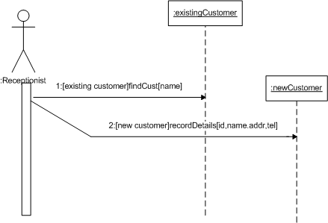
Conditional behaviour and branching
Putting a guard on a message means that the message will only be sent if the Boolean expression in the square brackets evaluates to true
Sequence diagram allow us to model conditional branching

Slide 16
Concurrency
Sequence diagram can also be used to model synchronous and asynchronous message
  Synchronous message : the object that sends the message must wait for a response from the object it calls
  Asynchronous message : the object that sends the message can invoke an operation on another object without interrupting its own processing; the two objects can process in parallel.

Slide 17
References
Britton, C.. (2005). A student Guide to Object Oriented Development. 01. Butterworth-Heinemann. Amsterdam. ISBN: 978-0-7506-6123-2.
Interaction Diagram, http://www.agilemodeling.com/artifacts/interactionOverviewDiagram.htm
Interaction Diagram, http://www.tutorialspoint.com/uml/uml_interaction_diagram.htm

Slide 18
Q & A

